Slide 1
Immigration
The German Experience
Notes:
http://commons.wikimedia.org/wiki/File:German_Flag_Wavy.jpg

Slide 2
Where is Germany?
Notes:
Maps courtesy of www.theodora.com/maps used with permission

Slide 3
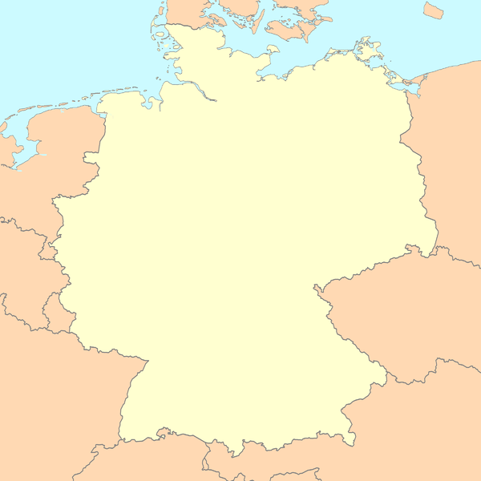
This is Germany
Notes:
http://commons.wikimedia.org/wiki/File:Germany_map_blank.png

Slide 4
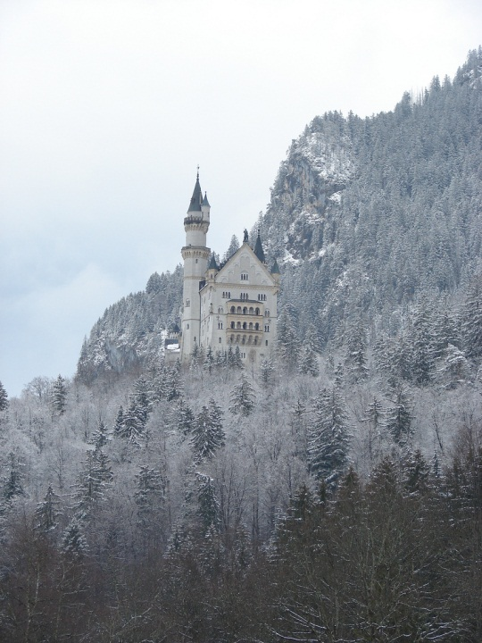
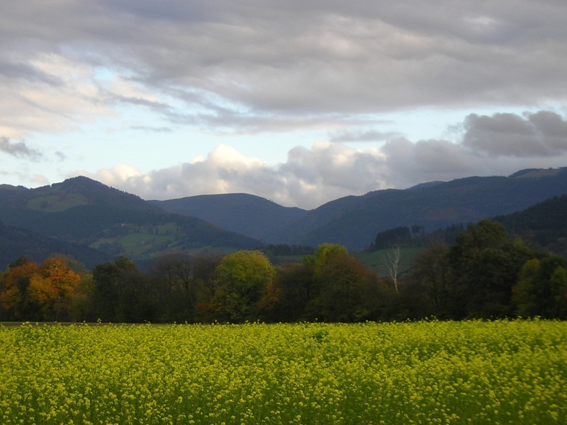
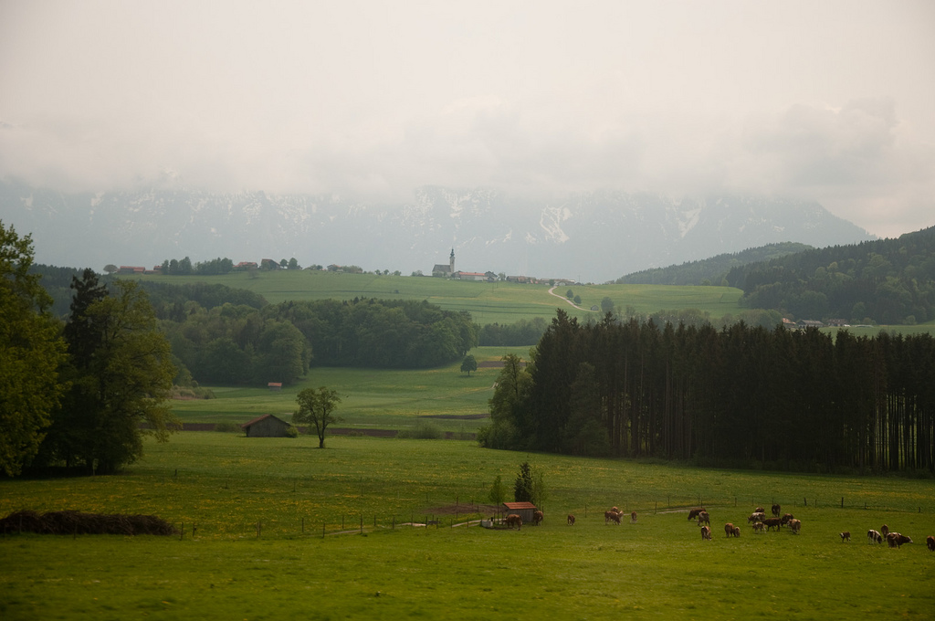
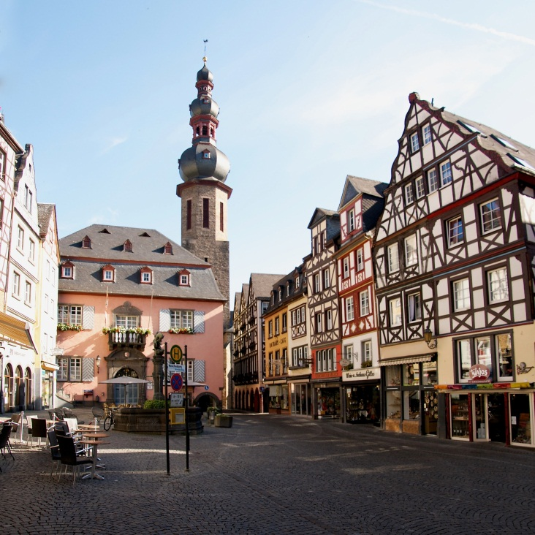
Images of Germany
Notes:
http://www.flickr.com/photos/davidgardner/267692525/
http://www.flickr.com/photos/8453990@N02/4271598625/
http://commons.wikimedia.org/wiki/File:Historic_city_centre_Cochem.jpg
http://www.flickr.com/photos/wenzday01/3570520526/

Slide 5
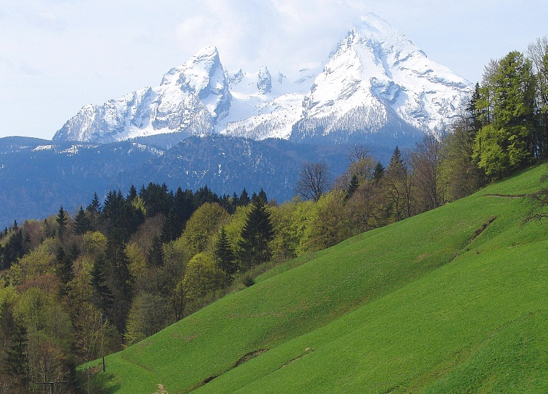
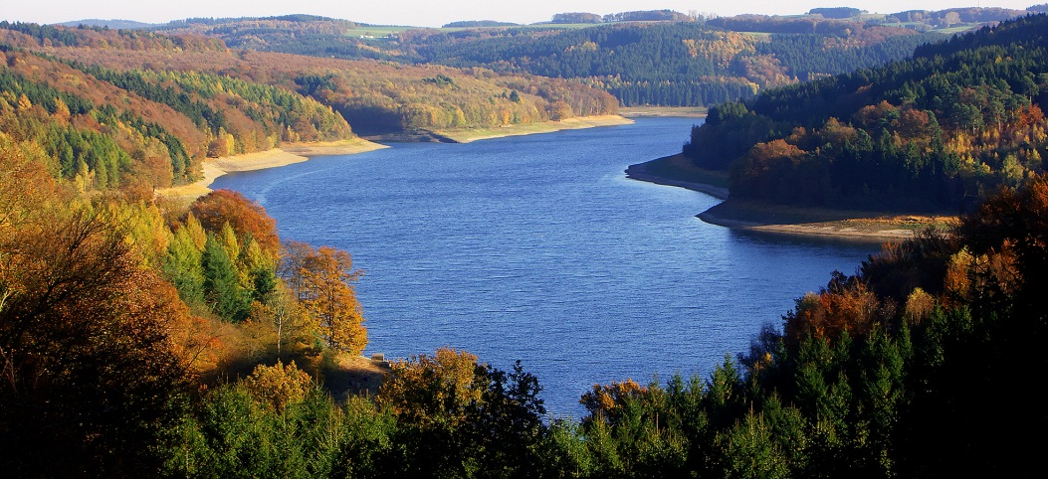
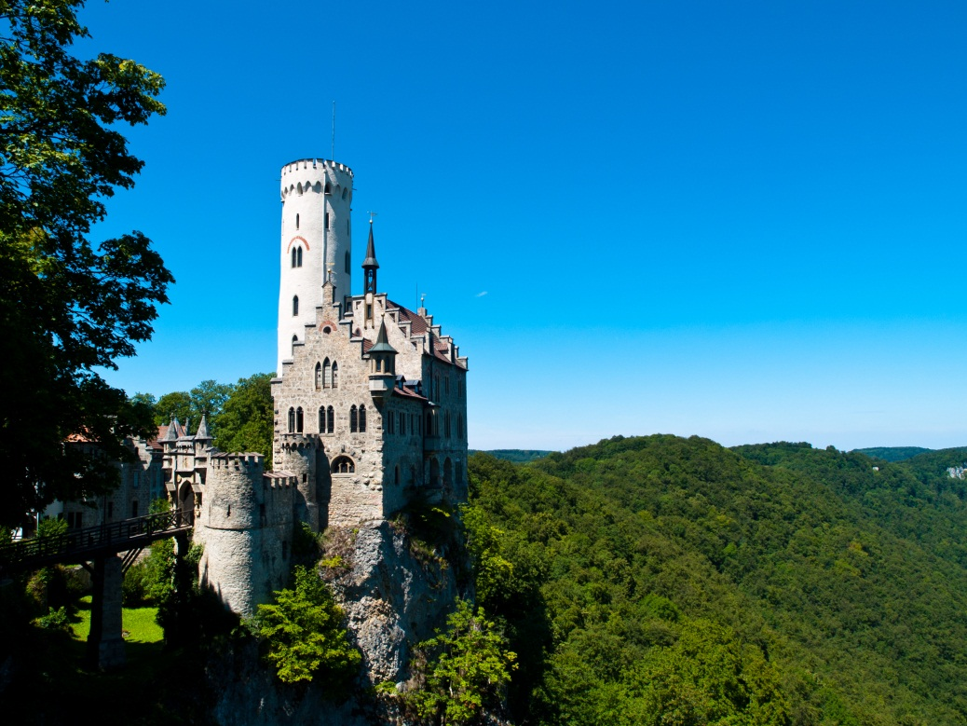
Images of Germany
Notes:
http://www.flickr.com/photos/depenbusch/6052704118/
http://commons.wikimedia.org/wiki/File:Watzmann_bei_Berchtesgaden,_Germany.jpg
http://www.flickr.com/photos/1yen/5966846929/lightbox/

Slide 6
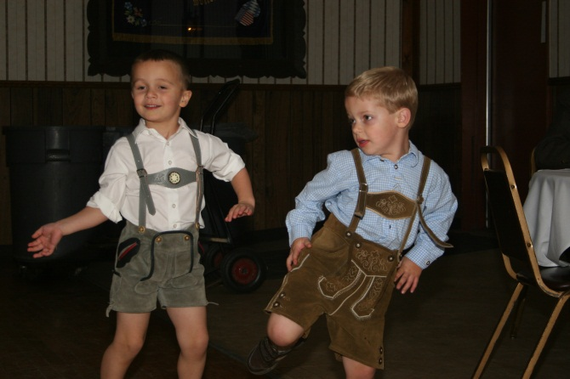
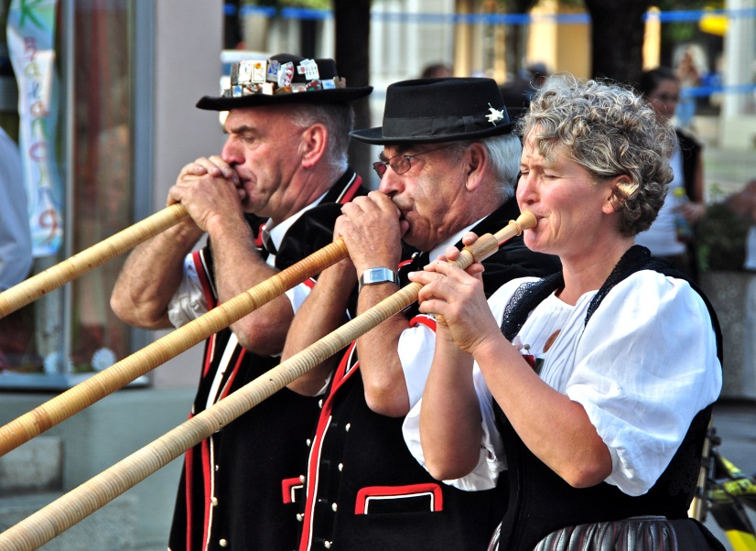
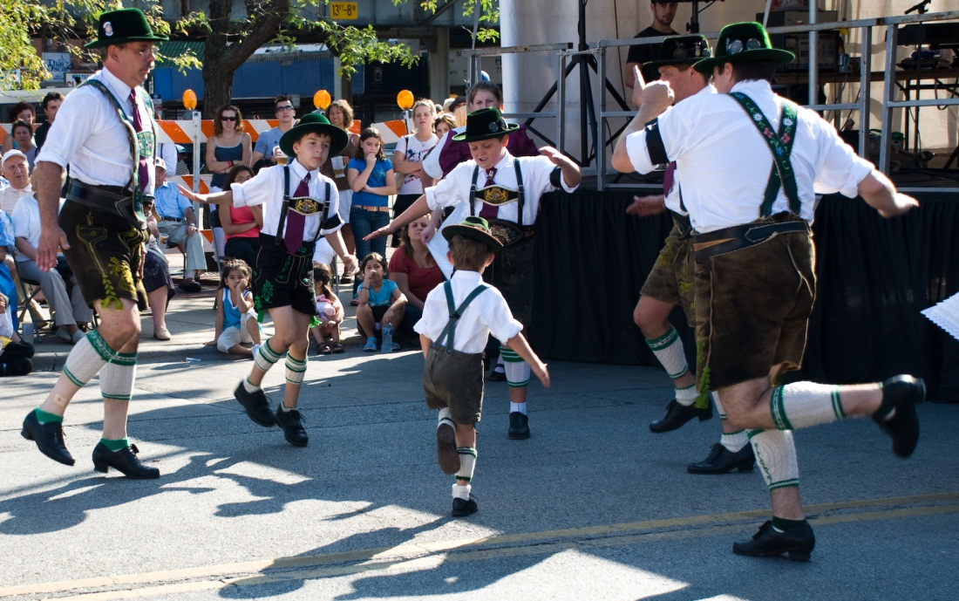
Images of Germany
Notes:
http://www.flickr.com/photos/brize/7755533536/
http://www.flickr.com/photos/phineasx/1354909755/lightbox/
http://www.flickr.com/photos/udommilwaukee/6866668151/
http://mygermantravels.com/2011/04/german-maypole/

Slide 7
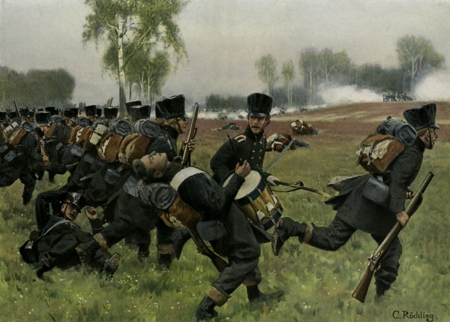
Why did People Decide to Leave Germany? Push Factors
1683- The first Germans came for religious freedom
1700s- Foreign armies were attacking Germany and many people wanted to live in a safe place
Notes:
http://www.fsegames.eu/forum/index.php?topic=5178.0

Slide 8
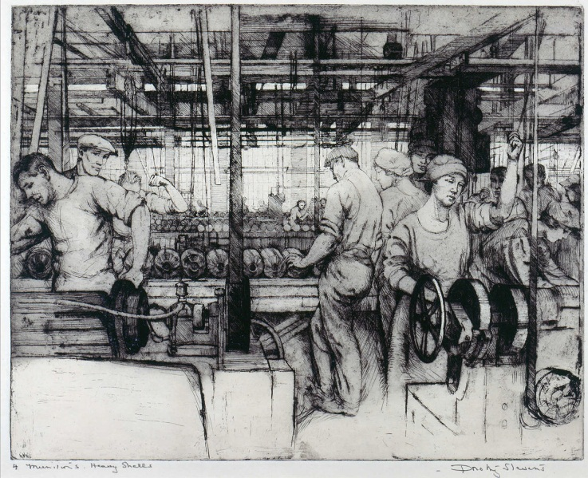
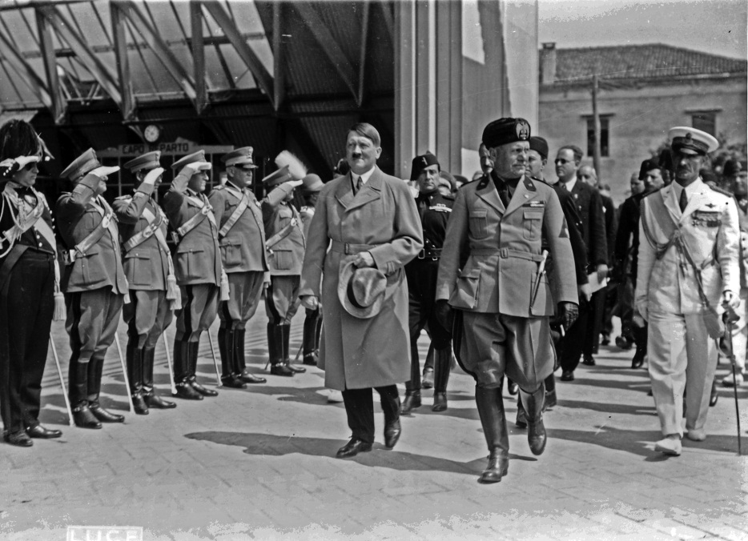
Why did People Decide to Leave Germany? Push Factors
1800s- Factories started using machines and many people had lost their jobs. Farmers had poor harvests, too.
1930s and 1940s- Many Germans left to escape Adolf Hitler’s Nazi government to live in a safe place.
Notes:
http://commons.wikimedia.org/wiki/File:Dorothy_Stevens_-_Munitions_Heavy_Shells.jpg
http://commons.wikimedia.org/wiki/File:HitlerMussolini1934Venice.jpg

Slide 9
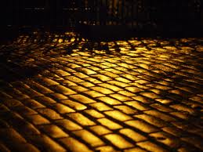
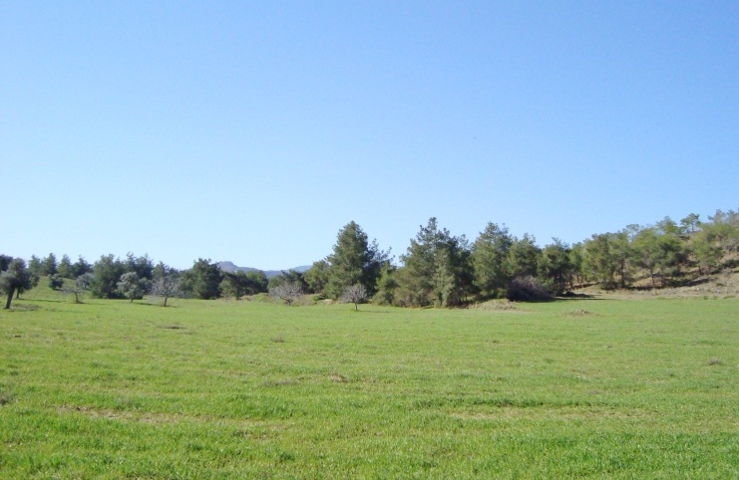
Why Choose America?
America offered religious freedom
America was safe, away from the wars in Europe
America is the “Land of Opportunity” with jobs for everyone
America had plenty of unsettled land for farming
Notes:
http://www.flickr.com/photos/54459164@N00/6181461699/
http://www.flickr.com/photos/dominicspics/4662872493/
http://commons.wikimedia.org/wiki/File:Religious_syms.svg
http://www.123rf.com/photo_7662064_a-black-and-orange-no-trespassing-sign-isolated-on-white.html
http://commons.wikimedia.org/wiki/File:Cyprus_countryside_in_Troodos_Mountains.jpg

Slide 10
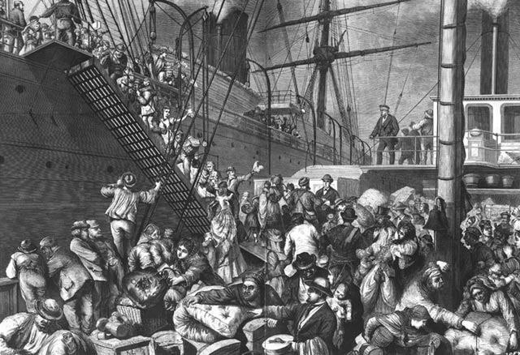
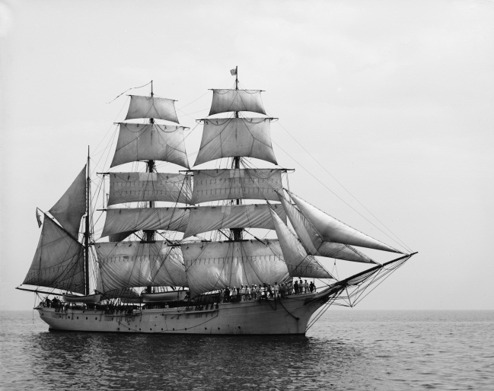
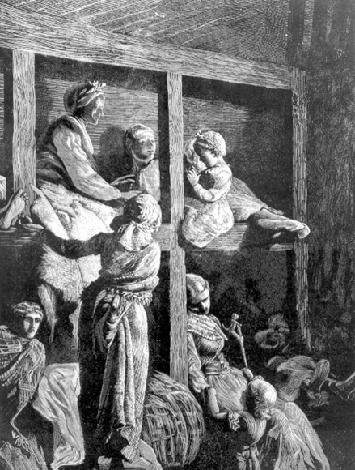
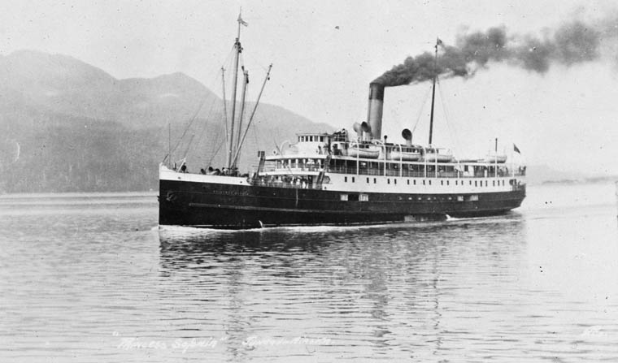
Getting to America
Early immigration- sailing ships
Long voyage-months
Crowded conditions
Sickness
By 1970- steamships
Shorter voyage-
2 or 3 weeks
Safer conditions
Notes:
http://commons.wikimedia.org/wiki/File:Unidentified_sailing_ship_-_LoC_4a25817u.jpg
http://en.wikipedia.org/wiki/File:Princess_Sophia_(steamship)_ca_1912).jpg
http://www.loc.gov/rr/european/imde/germchro.html
http://webpages.charter.net/mcarolan/ThomasCarolan.html

Slide 11
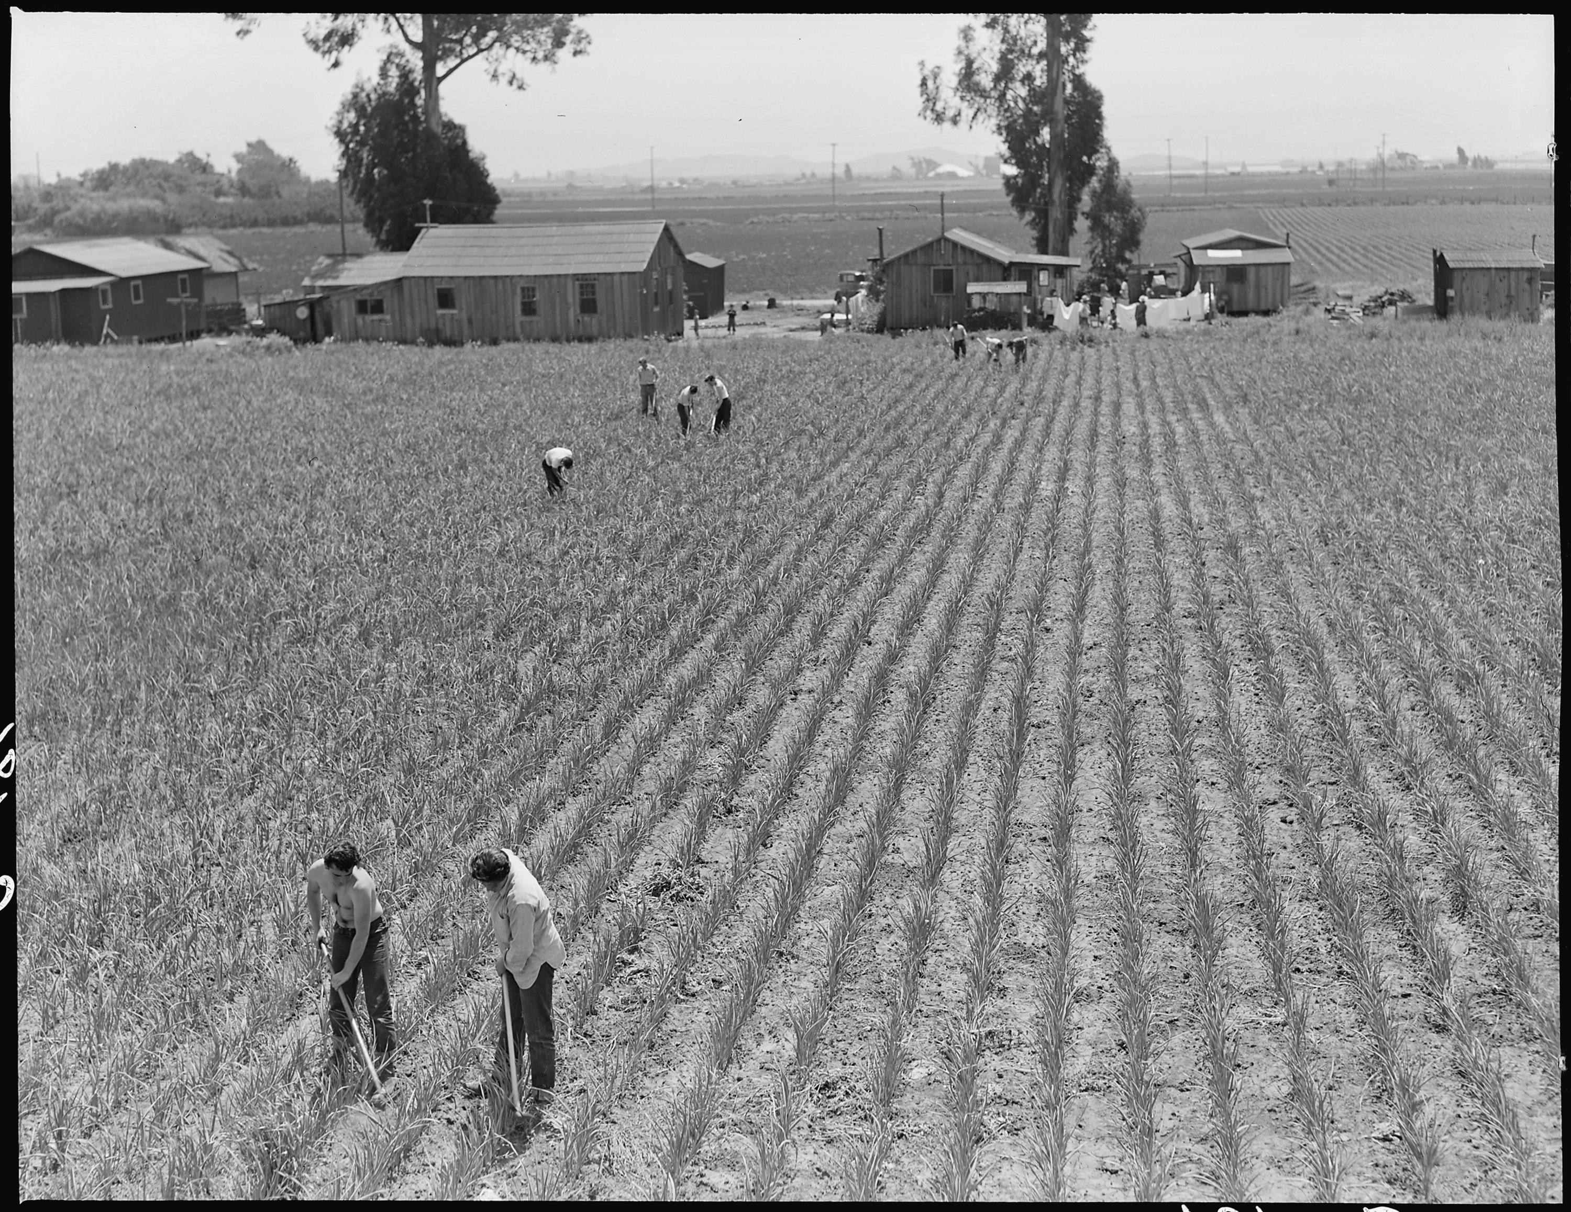
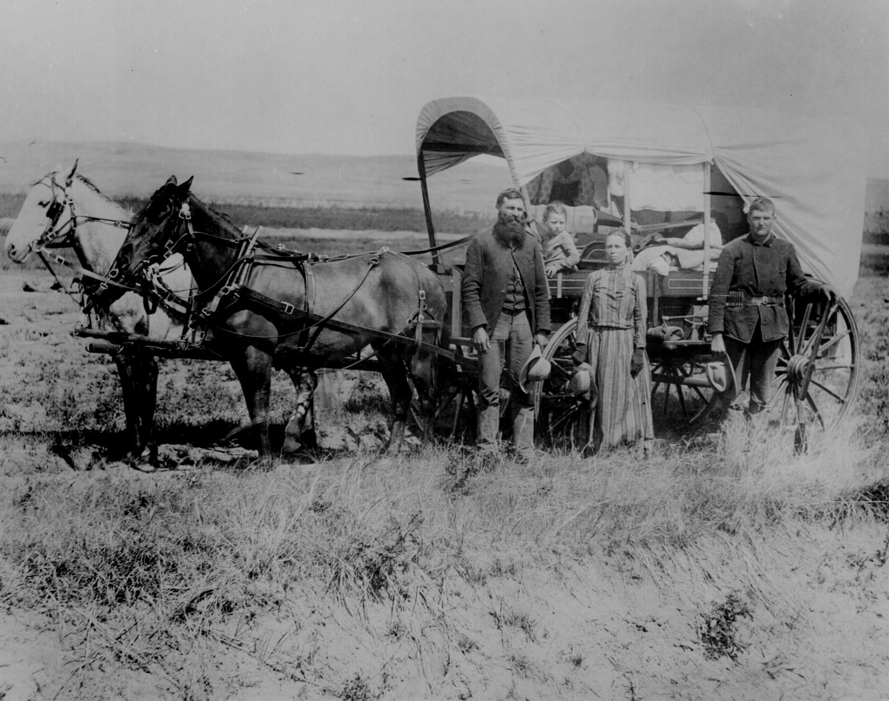
What America Was Like for German Immigrants
Germans were one of the early immigrant groups to arrive in the US
No major difficulties in settling here
Many Germans worked as farmers
German immigrants worked as bakers, nurses, blacksmiths, etc.
Notes:
http://thereaganwing.wordpress.com/2011/03/20/fraudulism-and-the-new-american-pioneer/
http://commons.wikimedia.org/wiki/File:San_Lorenzo,_California._Evacuation_of_farmers_of_Japanese_descent_resulted_in_agricultural_labor_s_._._._-_NARA_-_537535.jpg

Slide 12
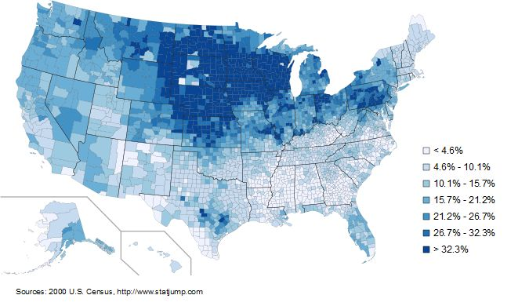
What America Was Like for German Immigrants
German immigrants arrived on the east coast of America
They moved to cities and town where other Germans were already living in the Midwest and West. They were pioneers.
Notes:
http://www.statjump.com/lists/german-people-dp2c159tc.html

