Slide 1
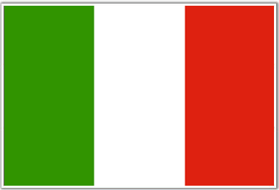
Immigration
The Italian Experience
Notes:
Maps courtesy of www.theodora.com/maps, used with permission.

Slide 2
Where is Italy?
Notes:
Maps courtesy of www.theodora.com/maps, used with permission.

Slide 3
This is Italy
Notes:
This file is licensed under the Creative Commons Attribution-Share Alike 3.0 Unported license.

Slide 4
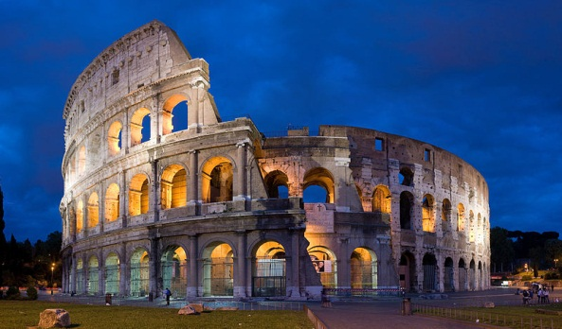
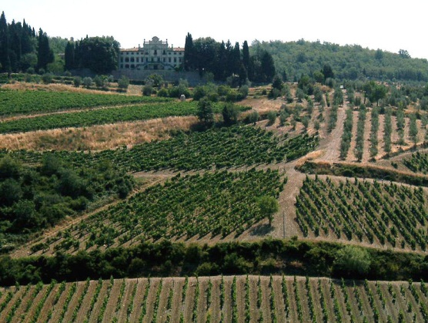
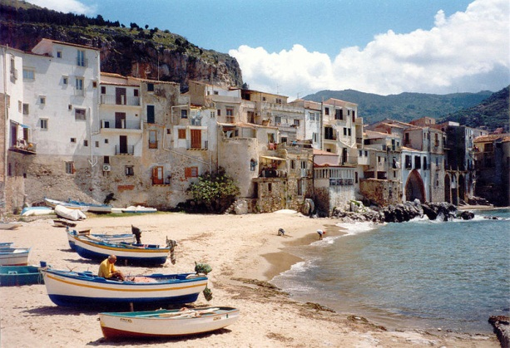
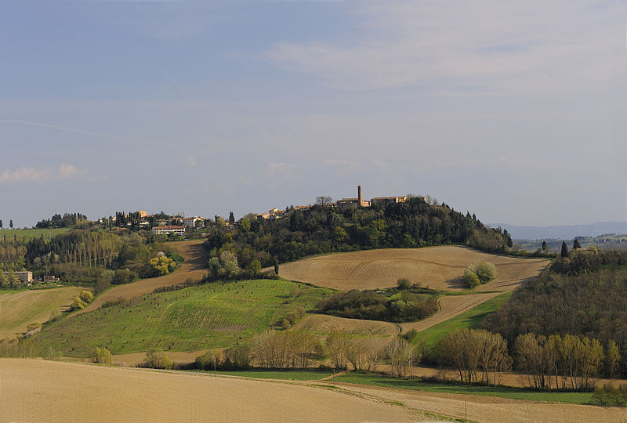
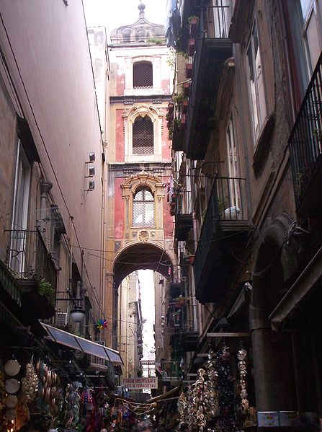
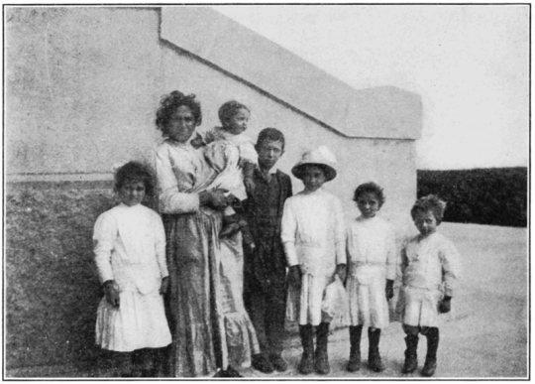
Images of Italy
Notes:
All images used under the Creative Commons Attribution-Share Alike 3.0 Unported license.
http://en.wikipedia.org/wiki/File:Colosseum_in_Rome,_Italy_-_April_2007.jpg
http://en.wikipedia.org/wiki/File:Colosseum_in_Rome,_Italy_-_April_2007.jpg
http://en.wikipedia.org/wiki/File:Pano_vico_d%27elsa.jpg
http://en.wikipedia.org/wiki/File:Cefalu_Strand.jpg
http://en.wikipedia.org/wiki/File:Chianti-colline2-2.jpg
http://commons.wikimedia.org/wiki/File:PSM_V82_D022_An_italian_family_at_ellis_island.png
http://commons.wikimedia.org/wiki/File:San_Gregorio_Armeno.jpg

Slide 5
Why did People Decide to Leave Italy? Push Factors
For a long time Italy was not united, but instead was made up of individual city-states that often warred with each other and that were frequently attacked by outside invaders.
In the early 1800s Italy began the process of unification, banding together to make one great nation.
Even once unification was complete, there was a difference between the north and south of Italy.
The north had all the money and power, while the south was extremely poor and were taxed heavily by the Italians in the north.
Southern Italy was so poor, that many Southern Italians couldn’t find work and couldn’t feed themselves or their families.
There were lots of natural disasters like earthquakes, droughts, and even a volcano erupting that added to the Italian people’s sadness.

Slide 6
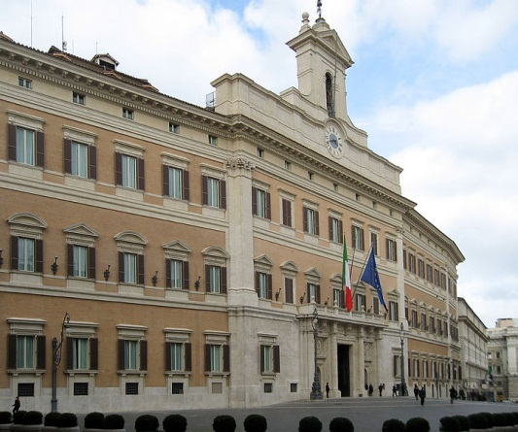
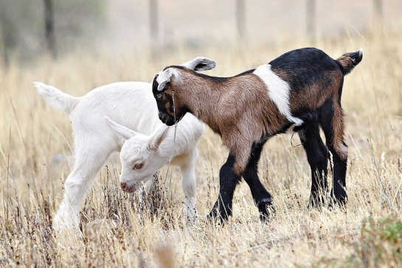
Southern Italy Suffered
The Italian government was spending lots of money by taxing the poor of Southern Italy.
Poor soil conditions meant the farmers couldn’t grow enough food to pay the taxes and feed themselves.
Southern Italians were even taxed for the number of sheep and goats they had!
Notes:
https://en.wikipedia.org/wiki/File:Palazzo_Montecitorio_Rom_2009.jpg
http://commons.wikimedia.org/wiki/File:Italian_Tomato_Farm.JPG
http://commons.wikimedia.org/wiki/File:Baby_goats_jan_2007.jpg

Slide 7
Why Choose America?
With America still growing, there were jobs available in the United States that were not available in Italy.
Even though Italians would take the toughest jobs with low pay, it was still more than what they could earn in Italy.
America was known as the Land of Opportunity where anyone could succeed.

Slide 8
What Italian Immigrants Anticipated.
Unlike other immigrant groups, Italians never expected to stay in America.
Italians wanted to come to America, earn money to send home, and then eventually return to Italy to live.
Most Italian immigrants were young men and most left their wives and children back in Italy, believing they would return to live with them once they made enough money.
Italians did not want to work on farms, as that would be more permanent employment. They wanted to be in the cities where they could work labor for short periods of time.

Slide 9
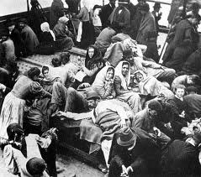
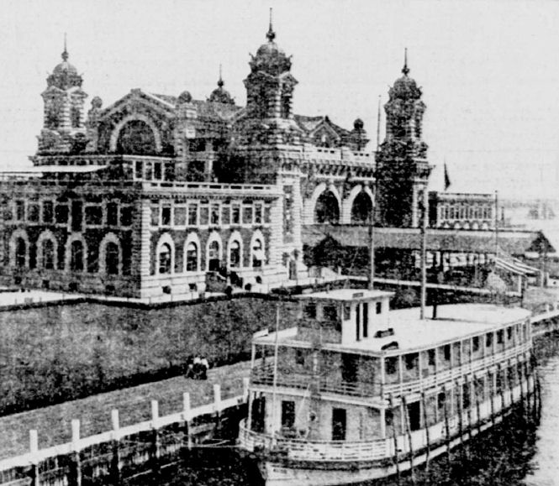
Getting to America
Italians traveled by boat to America
The trip was long and difficult
And when they arrived they still had to get through the Ellis Island inspectors.

Slide 10
What America Was Really Like When You Arrived.
Because most Italians couldn’t speak English and were unskilled labor (meaning they needed to be taught what to do), they were given the toughest, most labor-intensive work.
Italians suffered a lot of resistance from Americans and other immigrant groups who feared Italians would steal their jobs.
Because Italians couldn’t speak English, and many came from poverty where they didn’t have a formal education, they were looked down on as “dumb” and “stupid.”
Laws were passed to try and keep Italians from immigrating to the United States.

