Slide 1
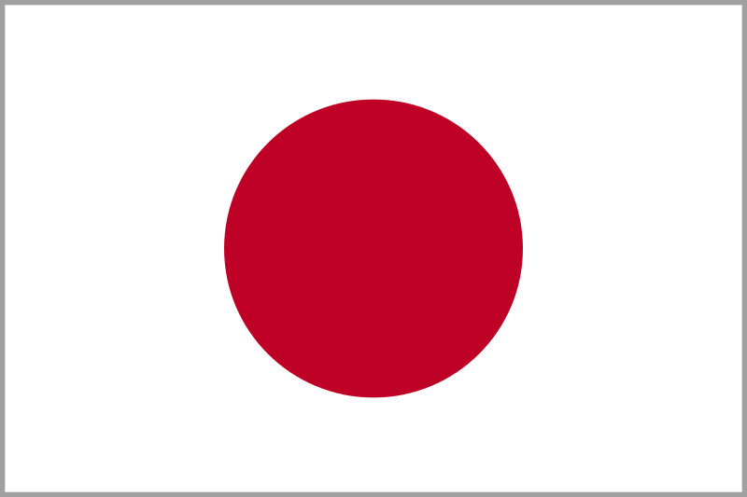
Immigration
The Japanese Experience
Notes:
https://commons.wikimedia.org/wiki/File:Flag_of_Japan_(bordered).svg

Slide 2
Where is Japan?
Notes:
"Maps courtesy of www.theodora.com/maps used with permission"

Slide 3
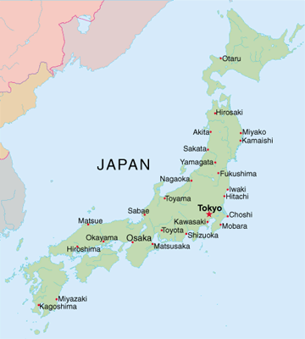
This is Japan
Notes:
Show Google map of Japan. Talk about relationship/distance to the US
http://www.the-digital-reader.com/2010/10/27/japanese-publishers-to-create-common-ebook-format/#.Ucx8xjtJPpU

Slide 4
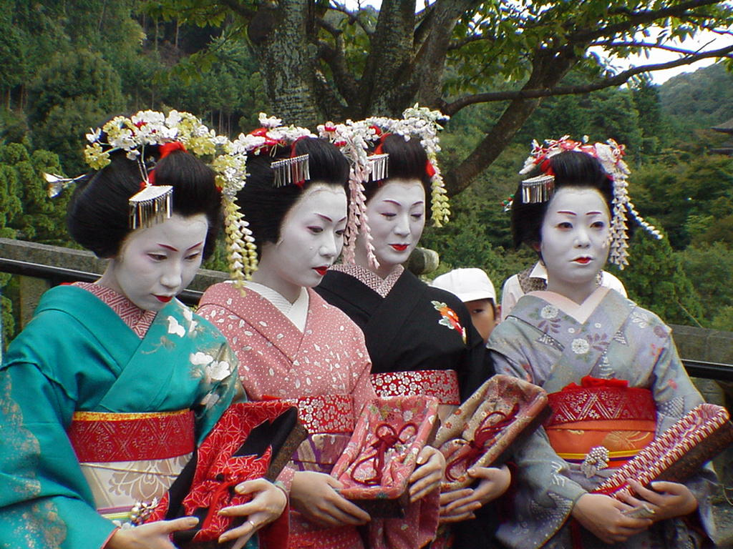
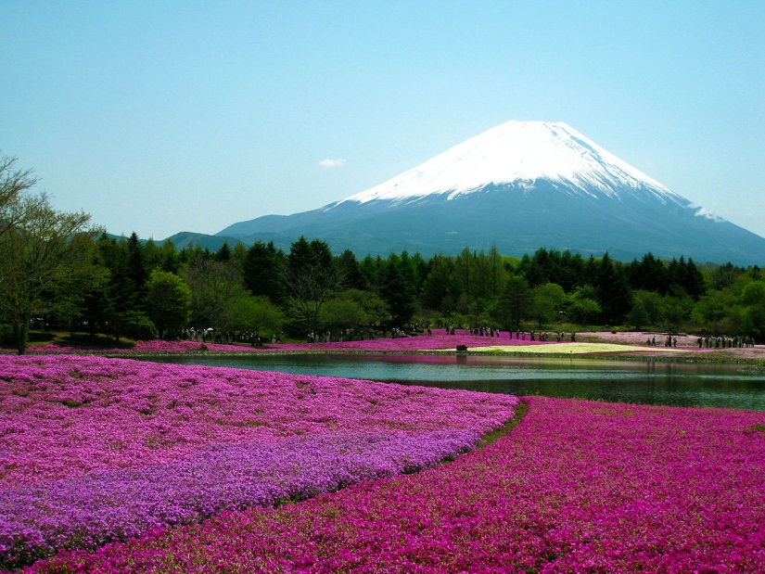
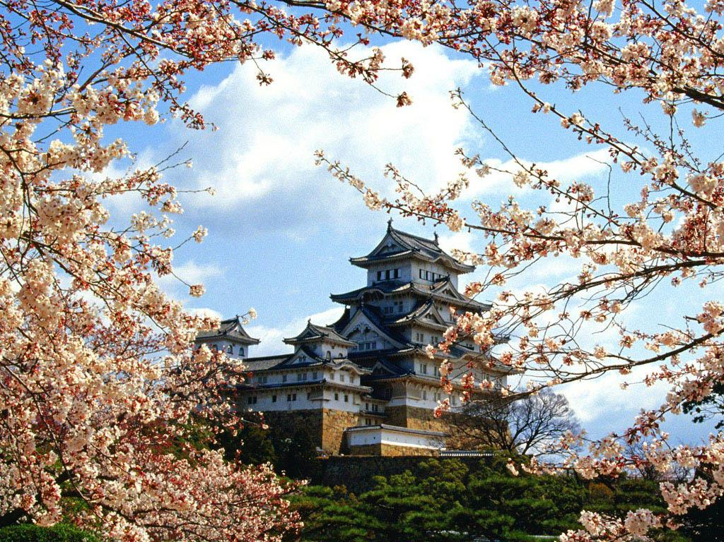
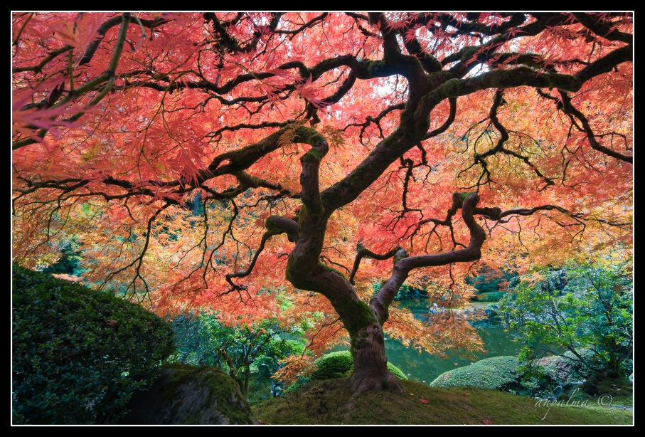
Images of Japan
Notes:
What do we know about Japan today? What are they known for? Famous for? Food…technology…big city
http://www.globeimages.net/postcard.img5964.htm
http://sunilsuwal.com/weekfive/mmc/culture/index.htm
http://www.famoustouristplaces.com/travel-japan-tourist-attractions-beautiful-scenery-of-japan-japan.html
http://www.flickr.com/photos/29738009@N08/2975466425/

Slide 5
Why did People Decide to Leave Japan? Push Factors
In 1854, the United States and Japan signed a treaty of trade, peace, and friendship.
This treaty opened Japanese harbors to American ships.
The Japanese government spent a lot of money to make their schools, businesses, and army more modern which led to unemployment, bankruptcies, and civil disorders.
The people were also charged with high taxes.
Many people left Japan because they could not pay the taxes.
Natural disasters also caused the Japanese to leave.

Slide 6
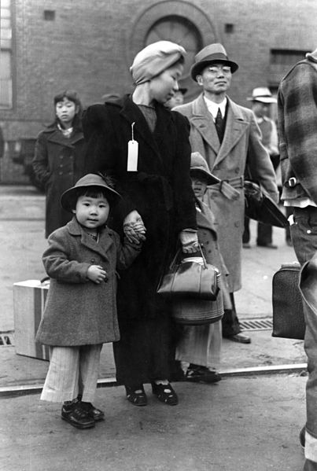
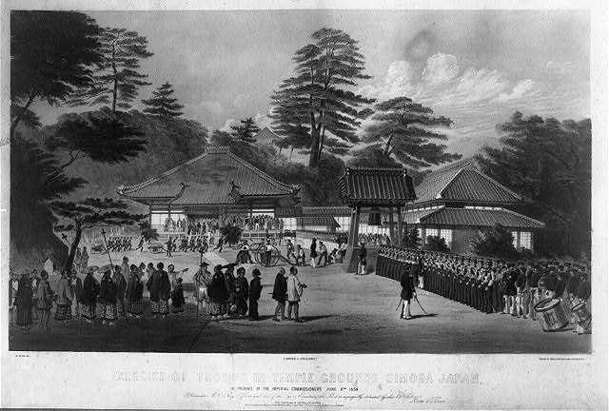
Why did People Decide to Leave Japan?
Notes:
http://upload.wikimedia.org/wikipedia/commons/a/a9/1854_shimoda_02.jpg
http://upload.wikimedia.org/wikipedia/commons/7/7c/Russell_Lee%2C_Japanese-American_family_waiting_for_relocation%2C_Los_Angeles%2C_1942.jpg

Slide 7
Why Choose America?
The Japanese immigrated to the Unites States (mainly Hawaii) because there was more job opportunity
Many worked on the sugarcane or pineapple plantations
Medical care and living conditions were better
Hope for a new life, jobs, freedom

Slide 8
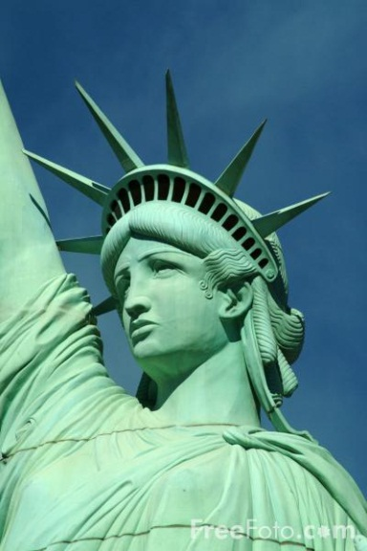
What Japanese Immigrants Anticipated
Work—gain wealth by working in the Hawaiian plantations
Opportunity to provide food for their families
Security, education and better medical care
Men immigrated first, leaving wives and children at home, hoping to earn money and return home
Notes:
http://www.freefoto.com/preview/1216-02-59/Statue-of-Liberty--New-York-New-York-Hotel--Las-Vegas--Nevada--USA

Slide 9
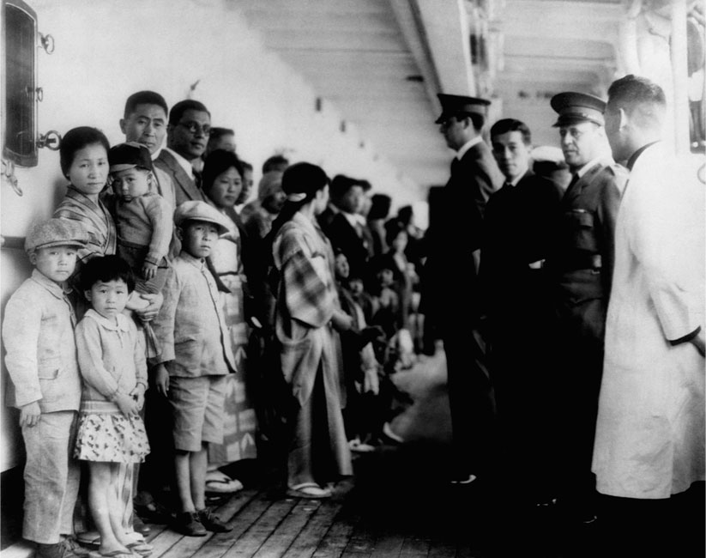
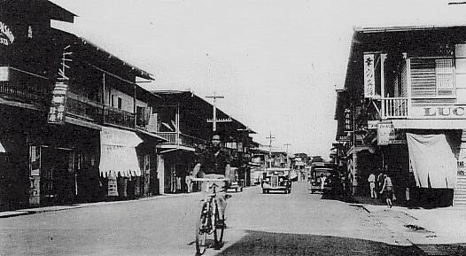
Getting to America
From 1885 to 1924, about 180,000 Japanese immigrants came to the United States
Japanese immigrants had their own neighborhoods in the poorer parts of U.S. cities, such as Los Angeles, California
Japanese immigrants arriving at Angel Island
Japantown forms
Notes:
http://teacher.scholastic.com/activities/immigration/tour/
https://en.wikipedia.org/wiki/File:Davao_Japantown_in_1930s.JPG

Slide 10
What America Was Really Like When You Arrived
Many people worked as farmworkers, railroad workers and miners
Early Japanese immigrants were not allowed to become U.S. citizens or to own land
Many Americans did not like the Japanese because of their skin color and how they looked. In 1924, the United States changed their laws to stop all immigration from Japan.
After Japan attacked Pearl Harbor, Hawaii, in 1941, the United States entered World War II.
Because so many Japanese Americans were living in the U.S., they were forced to live in camps where they stayed until the end of the war.
Notes:
Pearl Harbor is where the naval forces were located. Bombing of Hiroshima at the end of World War II in 1945 (in an attempt to end the war). Anyone ever read Sadako?

Slide 11
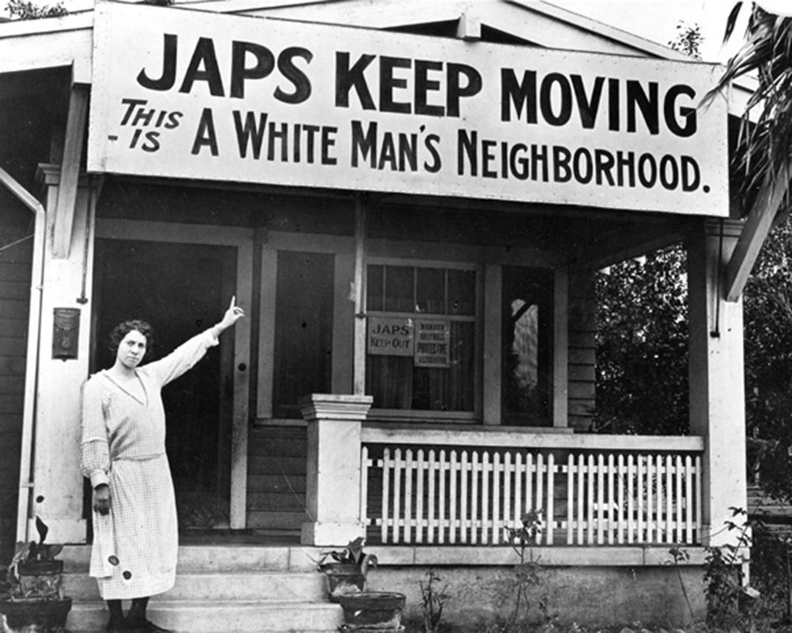
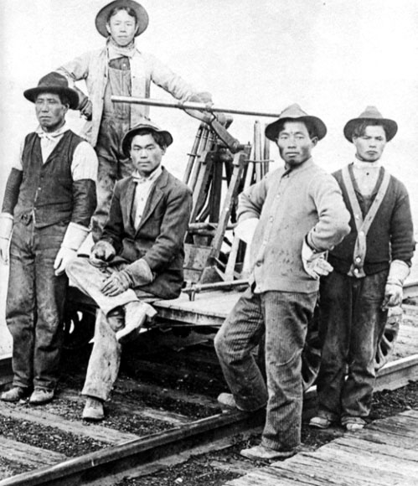
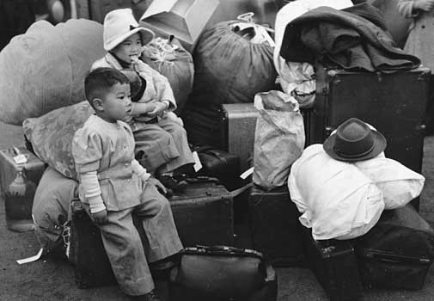
Notes:
http://www.latinamericanstudies.org/japanese-immigrants-1.htm
http://sfcitizen.com/blog/tag/protest/
http://www.britannica.com/EBchecked/media/122888/Japanese-American-children-being-relocated-to-internment-camps-1942

