Slide 1
L E A R N I N G A B O U T T H E
10 PRINCIPLES

Slide 2
L E A R N I N G A B O U T T H E
1 0 P R I N C I P L E S
The Learner-Active, Technology-Infused Classroom
embodies ten key principles.
Before you begin, be sure you have a copy of the
document, Ten Principles of the Learner-Active,
Technology-Infused Classroom. You can use this sheet
to make notes as you view the following slides.

Slide 3
L E A R N I N G A B O U T T H E
1 0 P R I N C I P L E S
Higher-Order
Open-Ended Thinking
“While it is true that one must master the
lower levels of Bloom’s Taxonomy before
achieving the higher, attempting to
build higher-order skills creates a felt need
for the lower order.”
- Dr. Nancy Sulla
Examples:
Rather than merely presenting back
information that they learned, students
seek out information while learning to solve
open-ended problems.
Teachers construct problems whose solutions reside in the unknown, forcing students to
grapple with content that drives them back to what is known.

Slide 4
L E A R N I N G A B O U T T H E
1 0 P R I N C I P L E S
High Academic Standards
“Teachers must overcome the tendency to teach to the level of the lowest-performing students and, instead, teach to a high level
and help all students reach that level through
differentiated opportunities to learn.”
- Dr. Nancy Sulla
Examples:
The expert column of an analytic rubric
pushes students to tackle extended content
and greater higher-order thinking related to
the content.
The classroom walls are filled with resources to push student thinking.

Slide 5
L E A R N I N G A B O U T T H E
1 0 P R I N C I P L E S
Learning from a
Felt Need
“When students experience a felt need to
learn, and they are the provided with
just-in-time instruction, they retain
that learning.”
- Dr. Nancy Sulla
Examples:
Students are presented with problem-based
tasks at the start of a unit of study that drive
the need to learn concepts and skills.
Teachers ask students to read the analytic
rubric at the start of a unit, identifying what they will need to learn in order to address
the problem. From there, the teachers design instructional opportunities.

Slide 6
L E A R N I N G A B O U T T H E
1 0 P R I N C I P L E S
Global Citizenship
"Making direct connections to other countries in your classroom activities, students can engage in online activities with students in other parts of the world.”
- Dr. Nancy Sulla
Examples:
Students gather information through the
Internet on issues and events from around
the world.
Students engage with outside experts and
students around the world through technology, showing evidence of their understanding
of cultural differences.

Slide 7
L E A R N I N G A B O U T T H E
1 0 P R I N C I P L E S
Technology Infusion
"Technology should be seamlessly infused into the learning environment with students accessing hardware and software as needed to pursue the greater goals of completing their problem-based tasks.”
- Dr. Nancy Sulla
Examples:
Students seek our technology when they
need it, in the course of pursuing other
learning goals.
Teachers use technology to deliver lessons,
have students engage in learning situations, communicate with students and parents,
gather and analyze student achievement data, and more.

Slide 8
L E A R N I N G A B O U T T H E
1 0 P R I N C I P L E S
Individual Learning Path
"If you provide students, even the youngest,
with tools for assessing their own
learning style and preferences, and you
offer various learning options, they will
learn to make appropriate choices, with you
providing guidance on those choices.”
- Dr. Nancy Sulla
Examples:
Teachers utilize assessment data to craft
individual student plans to address the
standards, suggesting specific activities or
creating individual expectations for students.
Students follow personal activity lists that address their learning styles and cognitive levels.

Slide 9
L E A R N I N G A B O U T T H E
1 0 P R I N C I P L E S
Student Responsibility
for Learning
"Children are inquisitive from birth. From the time they can talk, they start asking questions and they explore everything within their reach. The quest for learning is innate, and children learn a tremendous amount from their peers.”
- Dr. Nancy Sulla
Examples:
Students schedule their own time in the
classroom based on the teacher’s articulated
expectations, choices of a diverse range of
learning activities, and availability of a variety of resources.
Students reflect on their progress and practices and make adjustments to become more
effective and productive learners.

Slide 10
L E A R N I N G A B O U T T H E
1 0 P R I N C I P L E S
Connected Learning
"Students are motivated by real-world events,
fueled by accessibility via the Internet.
Brain research demonstrates that it is
important to connect learning to students'
lives; the reality-based shift in society
provides additional evidence of
the importance of connected learning.”
- Dr. Nancy Sulla
Examples:
Students engage in problems-based tasks
based on real-world scenarios.
Teachers present connections to other
subject areas in their benchmark lessons,
small-group mini-lessons, and other instructional materials.

Slide 11
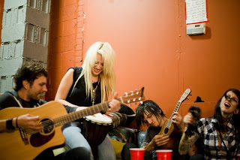
L E A R N I N G A B O U T T H E
1 0 P R I N C I P L E S
Collaboration
"Cooperative learning describes
a group working together and
typically dividing up tasks to
complete a particular assignment.”
- Dr. Nancy Sulla
Examples:
Two to four students meet with
a specific goal that is part of a
greater problems-solving effort.
Students use various structures to
ensure that all students have the
opportunity to participate and that all group interactions are positive.

Slide 12
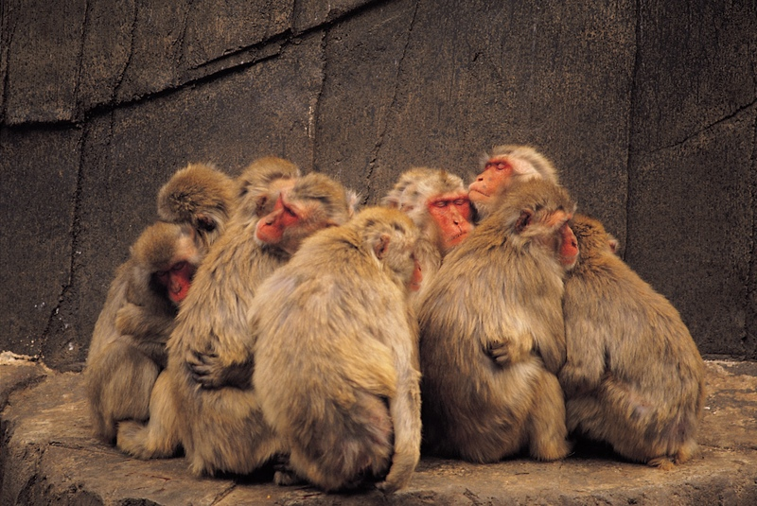
L E A R N I N G A B O U T T H E
1 0 P R I N C I P L E S
High Social Capital
"High social capital can be described
as the relationships that are forged in
a community between its adults and
its young people.”
- Dr. Nancy Sulla
Examples:
Teachers spend class time sitting
with students discussing their
work, goals and accomplishments.
Teachers design problem-based
tasks and instructional activities
that require student to engage with their parents, family members and other
adults in their lives.

